Slide 1


Slide 2



Slide 3

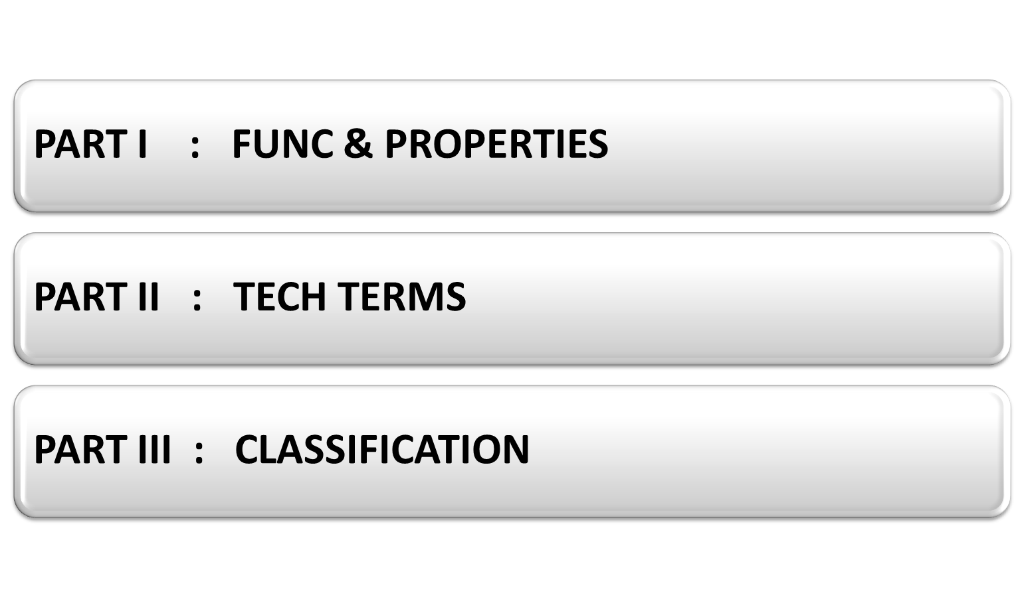

Slide 4


Slide 5


Slide 6

DEFINITION An Antenna is an electrical device designated to radiate or capture electromagnetic (EM) waves. It is a kind of transducer that converts radio frequency (RF) fields into alternating current or vice versa.

Slide 7

Used as transducer
Impedance matching device
Directs energy and suppresses unwanted sig
Senses EM Waves

Slide 8

Identical Impedance
Identical Directionality
Identical Effective Length
Reciprocity Theorem

Slide 9

PART II : TECH TERMS

Slide 10

DIRECTIVITY. Property of radiating more in particular dirns than the other.
ANT GAIN. Ratio of power radiated by a directional ant to produce a fd to the power radiated by an isotropic ant to produce the same fd at the same distance. gain is the measure of an ant’s directivity.
IMPEDANCE. Describes opposition to flow of current. for receiving and transmitting ant to be connected for max power transfer, their impedances must be same (matched).

Slide 11
RADIATION INTENSITY : Power radiated in a particular dirn
DIRECTIVE GAIN : Ratio of intensity of radiation to the avg radiation intensity
ANT BW : Range of frequencies over which antenna maintains its characteristics and parameters like gain, front to back ratio, SWR, radiation pattern, directivity etc. without considerable change.
TRANSMISSION LOSS : Ratio of power radiated to power recieved
Loss = P Radiated
P Received

Slide 12


Slide 13

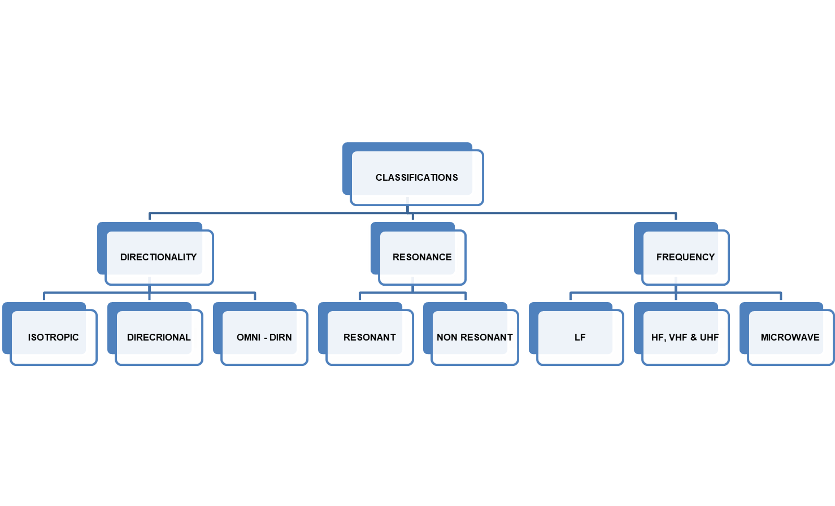

Slide 14


Slide 15

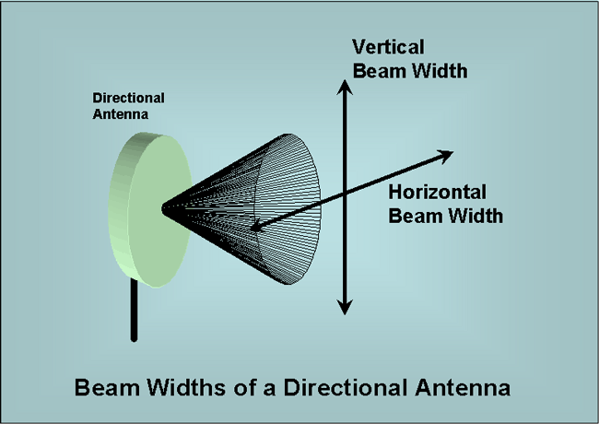
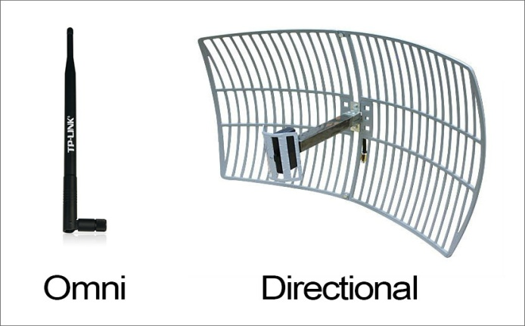
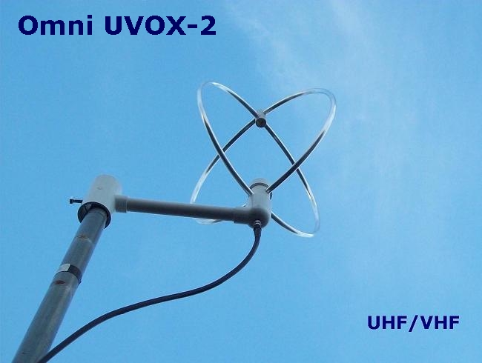

Slide 16

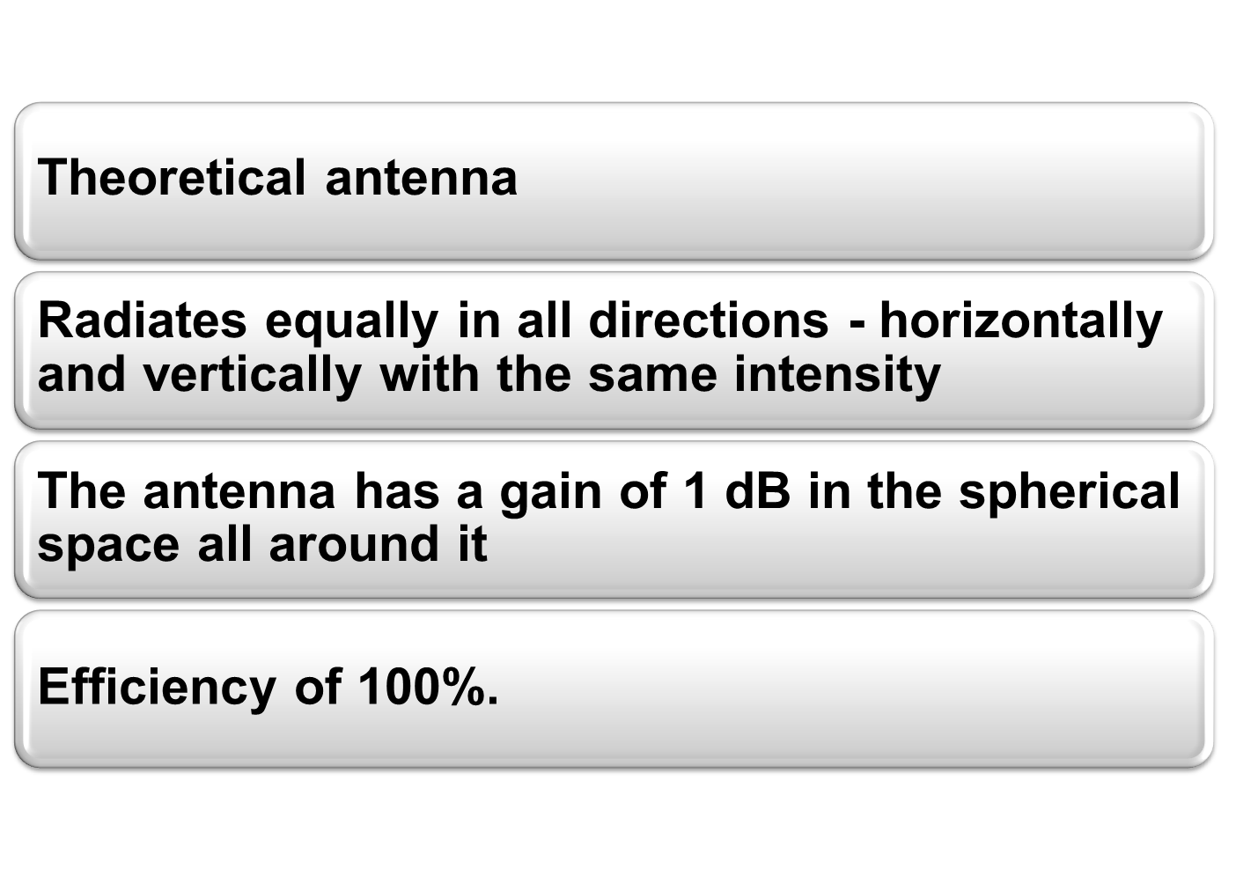

Slide 17

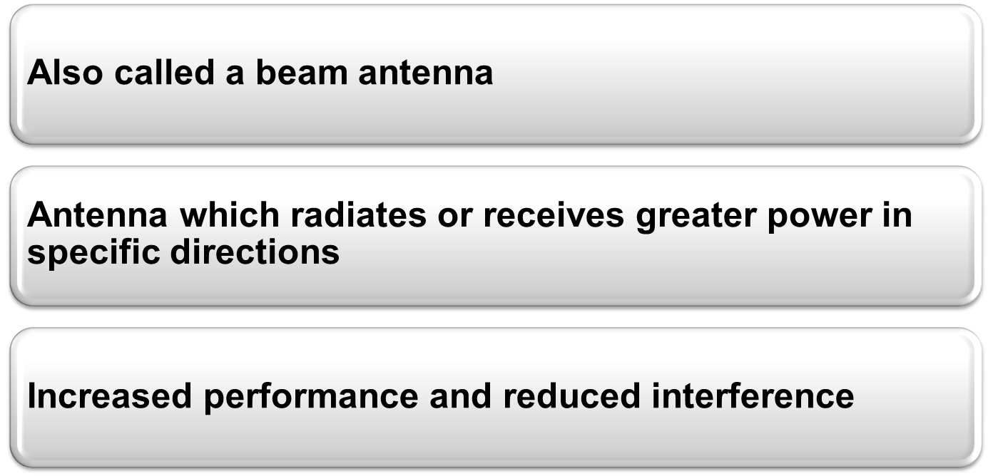
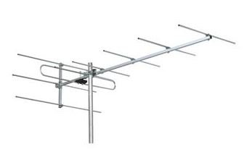
Notes:
Provide increased performance over dipole antennas omnidirectional antennas when greater concentration of radiation in a certain direction is desired

Slide 18

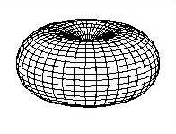

Slide 19
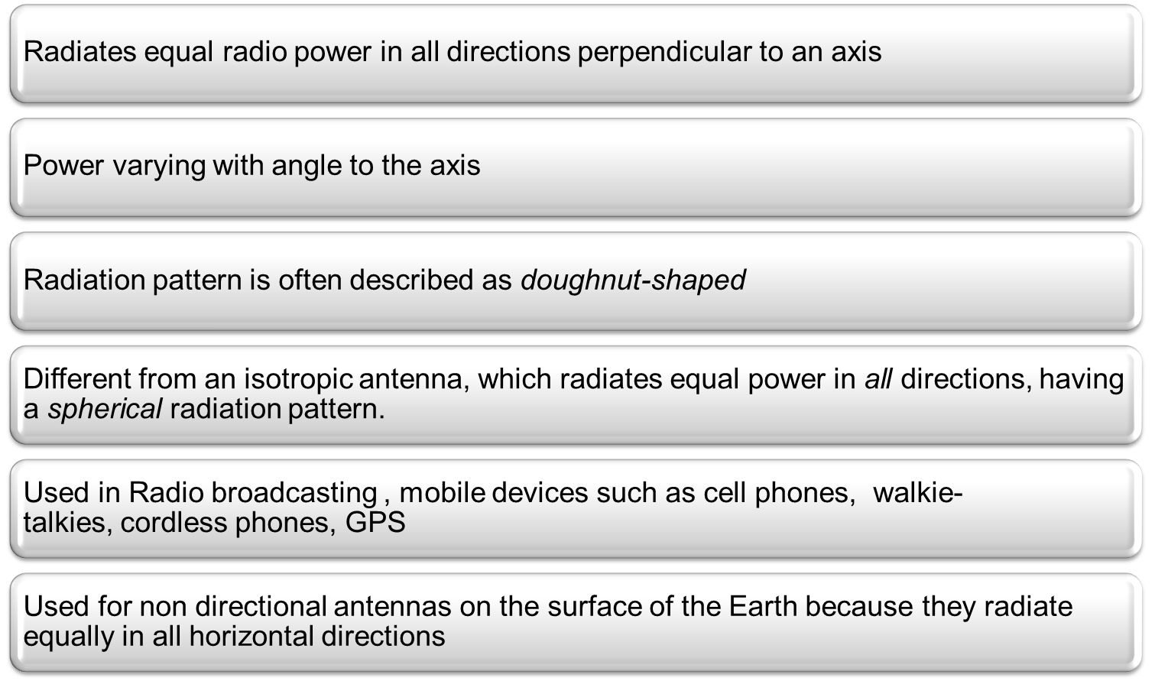

Slide 20


Slide 21

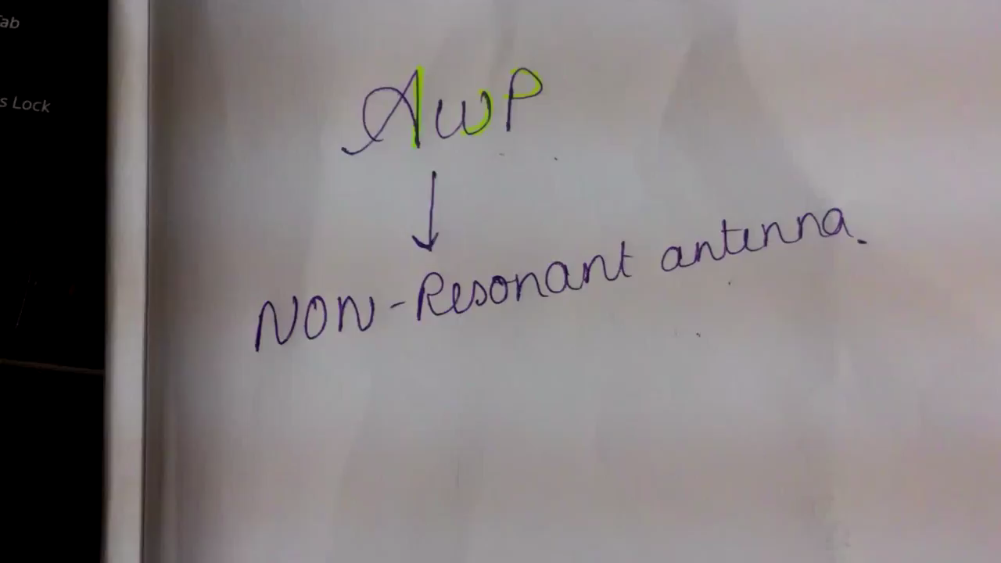

Slide 22


Slide 23

Low Freq : 30KHz to 300 KHz
HF , VHF, UHF Ant : 3-30 MHz, 30 - 300 MHz, 300 MHz - 3GHz
Microwave Ant : 4GHz to 90 GHz

Slide 24


Slide 25
Antenna Parameters
VSWR Voltage Standing Wave Ratio or Standing Wave Ratio of an antenna is the parameter to measure the effective length. If reflection coefficient is r then VSWR can be calculated as:
VSWR = 1+ r
1-r
Min VSWR is 1.0

Slide 26
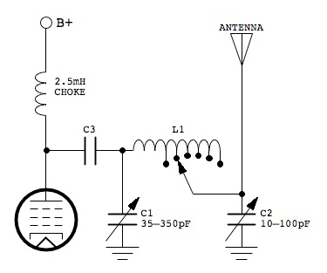
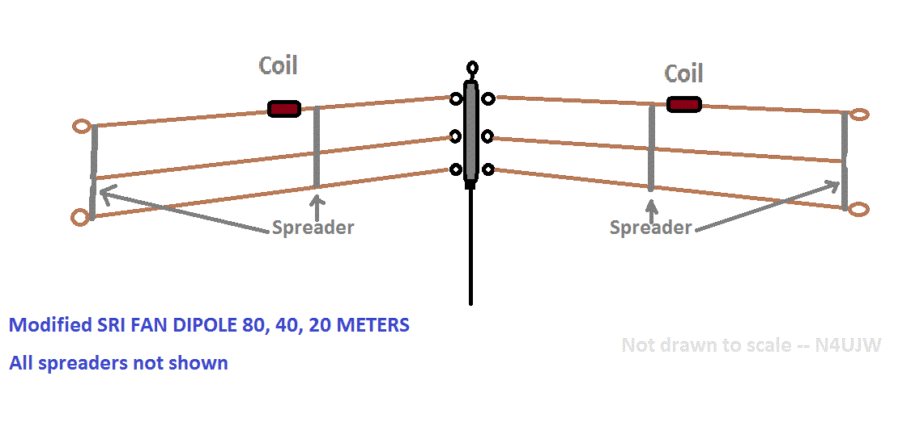
Classification of Antennas
Third Classification On the basis of Frequency.
(i) LF antennas.
(ii) HF, VHF, UHF antennas.
(iii) Microwave Frequency Antennas.
LF ANTENNAS

Slide 27
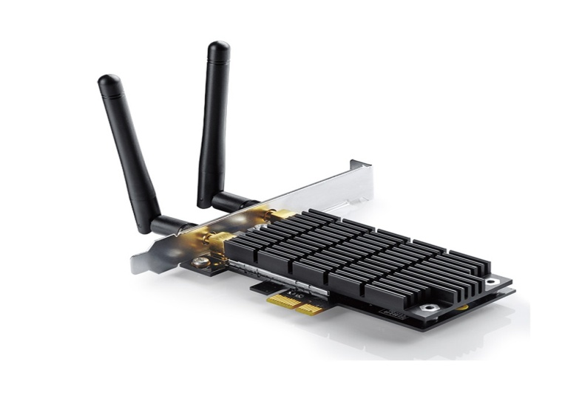
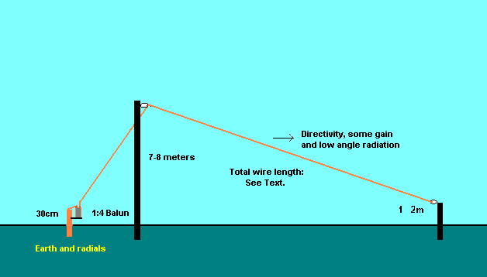
Classification of Antennas
(ac) Toner.
(ad) Inverted

Slide 28
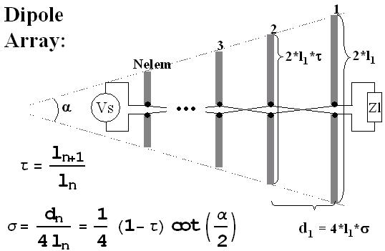
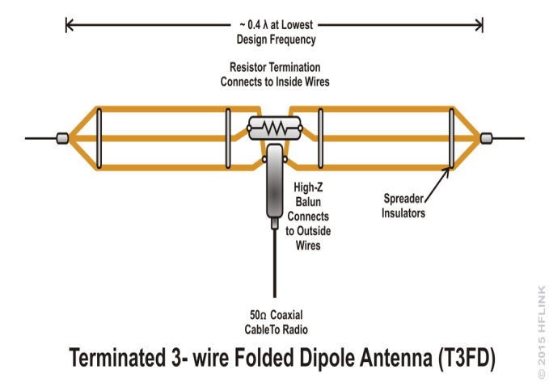
Classification of Antennas
(ii) VHF, UHF, HF Antenna.
(aa) Dipole Array (Broadside & End Fire)
(ab) Folded Dipole.

Slide 29
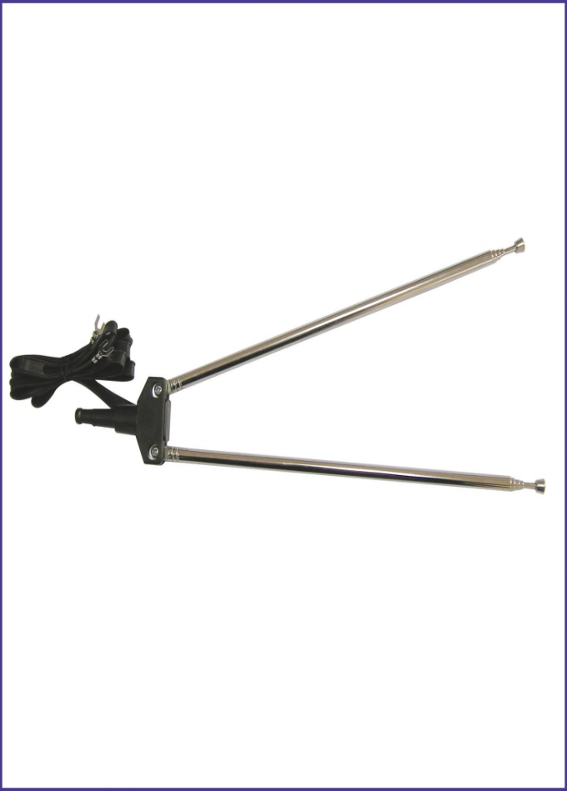
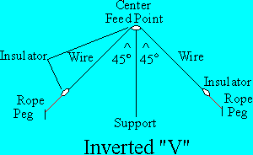
Classification of Antennas
(ac) V Antenna.
(ad) Inverted V Antenna.

Slide 30
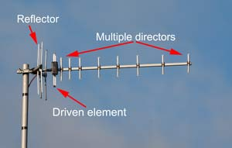
Classification of Antennas
(ae) Ohmic Antenna.
(af) Yagi Uda Antenna.

Slide 31
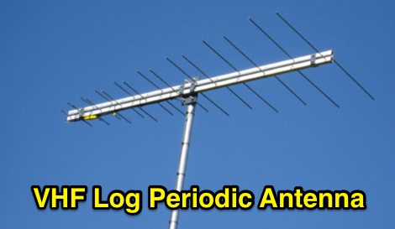
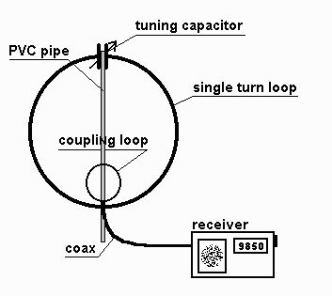
Classification of Antennas
(ag) Log Periodic Antenna.
(ah) Loop Antenna.

Slide 32
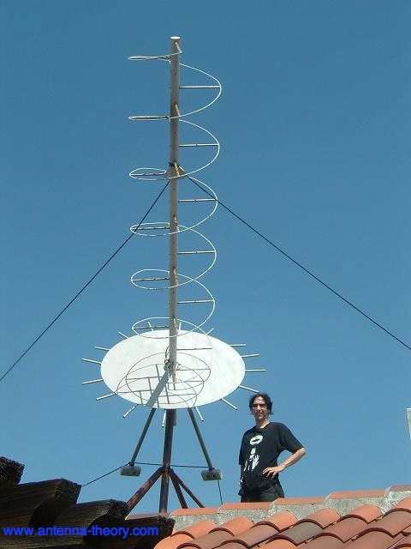
Classification of Antennas
(ai) Helical Antenna.
(aj) Whip Antenna.

Slide 33
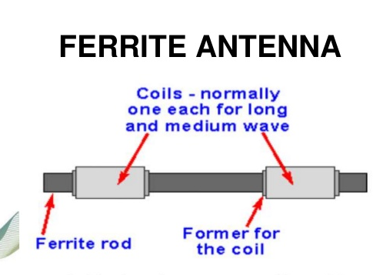
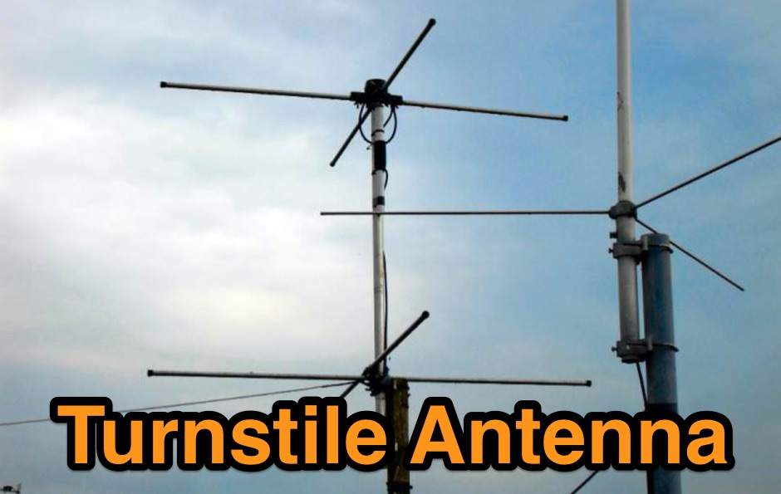
Classification of Antennas
(ak) Ferrite Rod Antenna.
(al) Turnstile Antenna.

Slide 34
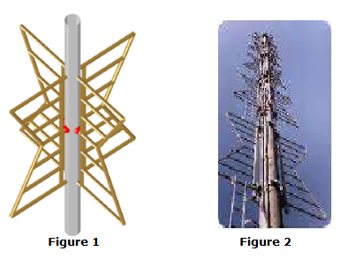
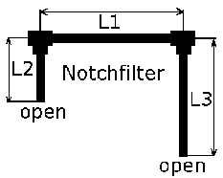
Classification of Antennas
(am) Super Transtile Antenna.
(an) Notch Antenna.

Slide 35
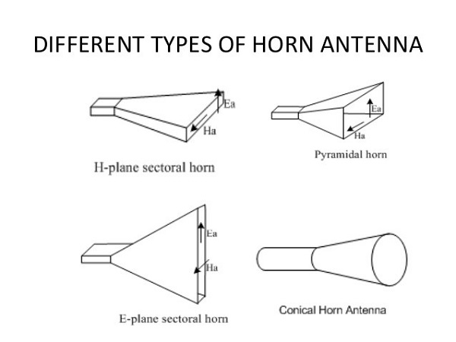
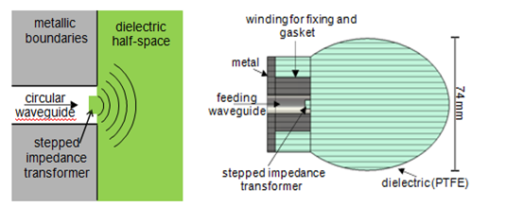
Classification of Antennas
(iii) Microwave Antennas.
(aa) Reflectors. Rod Reflector, Plane Reflector, Corner Reflector, Spherical Reflector, Parabolic Reflector and Cylindrical Reflector.
(ab) Horn Antennas.
(ac) Dielectric & Metal lens Antenna.

Slide 36
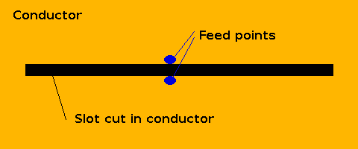
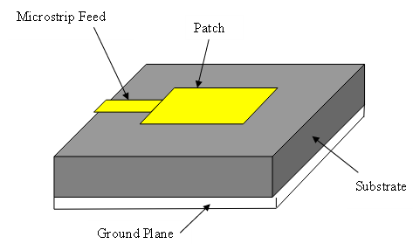
Classification of Antennas
(ad) Slot Antenna.
(ae) Microstrip Antenna.

Slide 37
ELECTROMAGNETIC SPECTRUM
Freq Band | Freq Range | Wavelength Range | Typical Uses
Very Low Freq (VLF) | 03-30 Khz | 30,000-10,000M | Long distance Point to-point communication
Low Freq (LF) | 30-300 Khz | 10,000-1000M | Marine Navigation
Med Freq (MF) | 300-3000Khz | 1000-100M | Broadcasting Marine
High Freq (HF) | 3-30 Mhz | 100-10M | Comn of all type
Very High Freq | 30-300Mhz | 10-1M | Television, FM radar, air, navigation, short wave.
Ultra High Freq (UHF) | 300-3000Mhz | 1M-10CM | Radar, Micro wave relays, short distance comn
Super High Freq (SHF) | 3-30 Ghz | 10 CM-1CM | Radar, radio relay navigation, experi mental
Extremely High Freq (EHF) | 30-300 Ghz | 1 CM- 1 MM | Experimental

Slide 38



